Slide 1
Quick Flikr Demo
Tarun Kumar Kalal

Slide 2
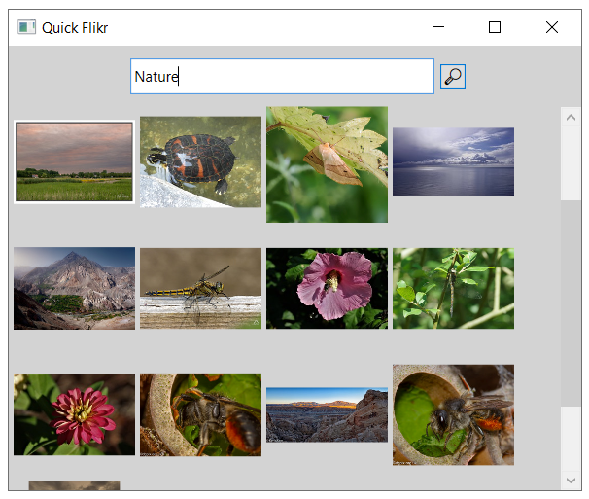
Objective
To create a program with a graphical user interface that takes in a search string and displays photographs that match the search string.

Slide 3

Business need
Requirements
1
2
3
4
Create GUI application
Search photograph by string
Request from public content from Flickr.com
Display photographs
on UI
Solutions Provided
WPF Application
Search capability based on string
Get photo on once click
Implemented on .NET Core 6
C#
Programming language
xUnit and Moq
Testing

Slide 4
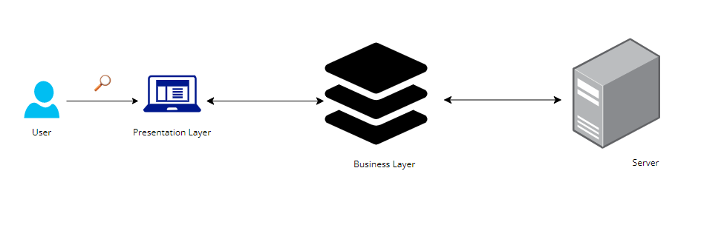
Architectural Diagram

Slide 5
Workflow Diagram
No photo found
No
Is input empty
Received Photos
No
Send Request
Yes
Start
Input
Search
Button
Send to GUI
End
Yes
No input

Slide 6
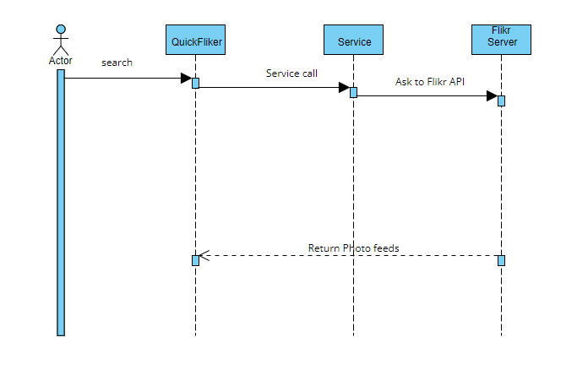
Sequence Diagram
Notes:
https://online.visual-paradigm.com/community/share/untitled-10r9dm6d7i https://online.visual-paradigm.com/app/diagrams/#diagram:proj=0&external=https://smgkybxgon.us-04.visual-paradigm.com/rest/diagrams/shares/diagram/be1cf024-4ff3-4e7c-a834-e738f4e7059b/content&name=Untitled

Slide 7
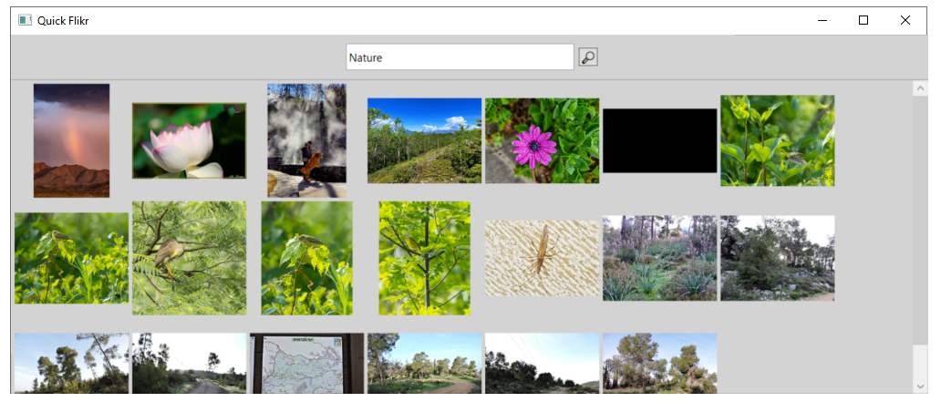
Quick Flickr Preview

Slide 8

Questions

Slide 9

Thank You!

